Slide 1
Class/Object Relationships
Inheritance & Compile Time Binding
CS(217) Object Oriented Programming
Abeeda Akram

Slide 2
Inheritance (is-a)
A
class A{
  int a;
public:
  A(int a=0){ this->a=a;}
  void print(){ cout<<a;}
};
class B: public A{
  int b;
public:
  B(int a=0, int b=0):A(a) { this->b = b;}
//override print function inherited from A
  void print() {
  A::print();
  cout<<b;
  }
//overload print function inherited from A
  void print(int x){ cout<<x+b; }
//Add New Function in class B
  void funb() { cout<<“funb”<<endl };
};
B
C

Slide 3
Inheritance (is-a)
A
class C: public B{
  int c;
public:
  C(int a=0, int b=0, int c=0) :B(a,b)
  { this->c = c;}
//override print function inherited from B
  void print() {
  B::print();
  cout<<c;
  }
//overload print function inherited from B
  void print(int x, int y){
  cout<<x+y+c;
  }
//Add New Function in class C
  void func(){ cout<< “func” <<endl; }
};
B
C

Slide 4
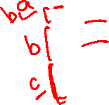
Inheritance (is-a) Compile Time Binding
A
Call the functions on object according to the type of object.
Cannot change compile time binding of static objects.
Can be changed for pointers or reference to objects.
void main(){
  A a1(2);
  a1.print(); //Base print called print a’s data
  B b1 (3,4);
  b1.print(); //Derived print called print a’s and b’s data
  b1.print(3); //overloaded print called
  b1.funb(); //new function defined in b called
  C c1 (5,6,7);
  c1.print(); //Derived print called print a’s and b’s and c’s data
  c1.print(3); //inherited print called
  c1.funb(); //inherited funb called
  c1.print(3, 5); //overloaded print called
  c1.func(); //new function defined in c called
}
B
a=2
C
b=4
a=3
c=7
b=6
a=5

Slide 5
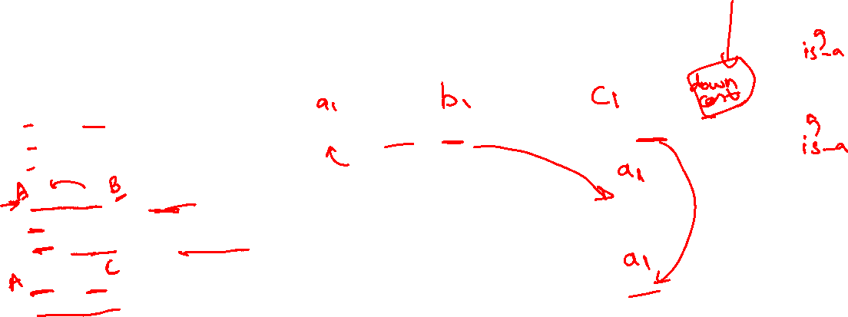
Inheritance (is-a) Object Slicing Problem
A
We can assign derived class object to base class object.
Only copy data of base class, derived portion is discarded.
Compile time binding system will call base class functions only.
void main(){
  A a1 (2);
  B b1 (3, 4);
  C c1 (5,6,7);
  a1 = b1; //slice b1 and copy in a1 the A’s portion only.
  a1.print(); //Base print called print A’s data only.
  a1.funb(); a1.print(3); //Compile time Error
  a1 = c1; //slice c1 and copy in a1 the A’s portion only.
  a1.print(); //Base print called print A’s data only.
  a1.funb(); a1.func(); //Compile time Error
  a1.print(3); a1.print(3, 4); //Compile time Error
}
B
c=7
b=4
b=6
a=2
a=3
a=5
C
a=3
a=5

Slide 6
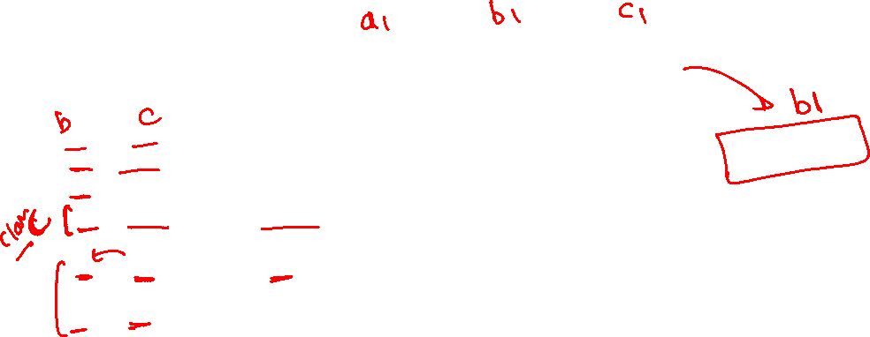
Inheritance (is-a) Object Slicing Problem
A
We can assign derived class object to base class object.
Only copy data of base class, derived portion is discarded.
Compile time binding system will call base class functions only.
void main(){
  A a1 (2);
  B b1 (3, 4);
  C c1 (5,6,7);
  b1 = c1; //slice c1 and copy in b1 the B’s portion only.
  b1.print(); //Base print called print B’s and A’s only.
  b1.print(3); //overloaded print called.
b1.func(); b1.print(3, 4); //Compile time Error
  c1 = b1; or c1 = a1;
  //Compile time Error: We cannot assign base class object to derived class.
  b1 = a1; //Every derived is a base but every base is not a derived.
}
B
b=4
c=7
a=3
b=6
a=2
a=5
C
b=6
a=5

Slide 7

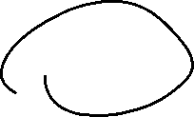

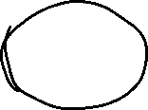


Inheritance (is-a) Object Slicing Problem
A
void fun(A a){
a.print(); //Base print called print A’s data only.
}
void fun2(B b){
b.print(); //Base print called print B’s data.
b.print(5);
}
void fun3(C c){
c.print(); //C’s print called.
c.print(5,9);
}
void main(){
  C c1 (5,6,7);
  fun(c1); //slice c1 to A’s object
  fun2(c1); //slice c1 to B’s object
  fun3(c1);
}
a
a=5
b=6
b
a=5
B
c=7
C
b=6
c
a=5
c=7
b=6
c1
a=5

Slide 8
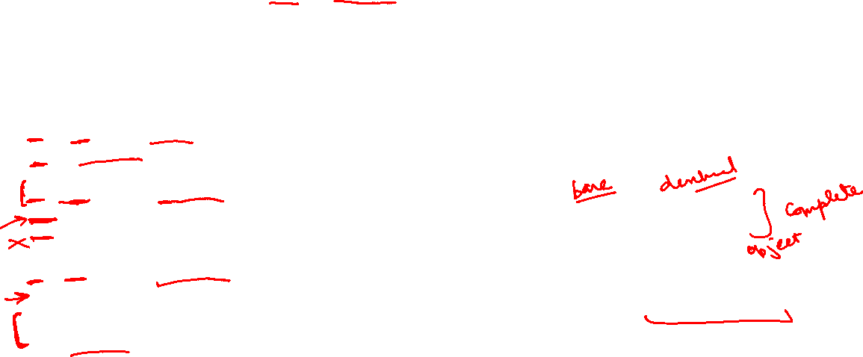
Inheritance (is-a) Base and Derived Pointers
A
Base class pointer can point to base or derived class objects.
Base class pointer can only see base class members, derived part still exist.
Can only call inherited functions not extra functions of derived class.
Compile time binding, system will call base class functions only according to type of pointer, not call overridden ones.
void main(){
  A * a1 = new A(2); //A’s pointer to A’s object
  a1->print(); //A’s print called.
  A * a2 = new B(3, 4); //A’s pointer to B’s object
  a2->print(); //A’s print called.
  a2->funb(); a2->print(3); //Compile time Error
  A * a3 = new C(5, 6, 7); //A’s pointer to C’s object
  a3->print(); //A’s print called.
  a3->funb(); a3->print(3); //Compile time Error
  a3->func(); a3->print(3,8); //Compile time Error
}
B
C
a1
a=2
a2
b=4
a=3
c=7
a3
b=6
a=5

Slide 9
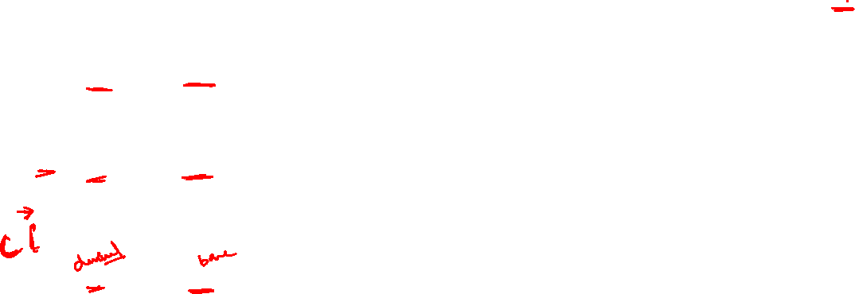
Inheritance (is-a) Base and Derived Pointers
A
Derived class pointer can only point to its own or further derived class objects.
Compile time binding, system will call derived class functions only according to type of pointer.
void main(){
  B * b1 = new B(9, 10); //B’s pointer to B’s object
  b1->print(); //B’s print called.
  b1->funb(); b1->print(3);
  B * b2 = new C (5, 60, 70); //B’s pointer to C’s object
  b2->print(); //B’s print called.
  b2->funb(); b2->print(3);
  b2->func(); b2->print(3,8); //Compile time Error
  B * b3 = new A(2); //Error: B’s pointer to A’s object
  //Every derived is a base but every base is not a derived.
  //Allowed if explicit cast made
}
B
b1
b=10
a=9
C
c=70
b2
b=60
a=5

Slide 10

Inheritance (is-a) Base and Derived Pointers
A
Derived class pointer can only point to its own or further derived class objects.
Compile time binding, system will call derived class functions only according to type of pointer.
void main(){
  C * c1 = new C(5, 60, 70); //C’s pointer to C’s object
  c1-> print(); //C’s print called.
  c1-> funb();
  c1-> print(3);
  c1-> func();
  c1-> print(3,8);
  C * c2 = new B(5,6); //Error: C’s pointer to B’s object
  C * c3 = new A(2); //Error: C’s pointer to A’s object
  //Every derived is a base but every base is not a derived.
  //Allowed if explicit cast made
}
B
C
c=70
c1
b=60
a=5

Slide 11
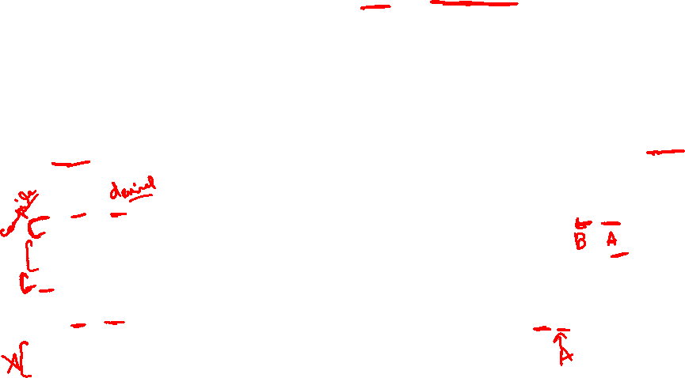




Inheritance (is-a) Base and Derived references
A
Base class reference can be created for base or derived class objects.
Base class reference can only see base class members, derived part still exist.
Can only call inherited functions only not extra functions of derived class.
Compile time binding, system will call base class functions only according to type of reference , not call overridden ones.
void main(){
  A a(2); B b(3, 4); C c(5,6,7);
  A & a1 = a;
  a1.print(); //A’s print called.
  A & a2 = b; //A’s reference to B’s object
  a2.print(); //A’s print called.
  b.print(3); //B’s print called
  b.funb(); //new function defined in B called
  a2.funb(); a2.print(3); //Compile time Error
  A & a3 = c; //A’s reference to C’s object
  a3.print(); //A’s print called.
  a3.funb(); a3.print(3); //Compile time Error
  a3.func(); a3.print(3,8); //Compile time Error
}
B
C
a,a1
a=2
b, a2
b=4
a=3
c=7
c,a3
b=6
a=5

Slide 12
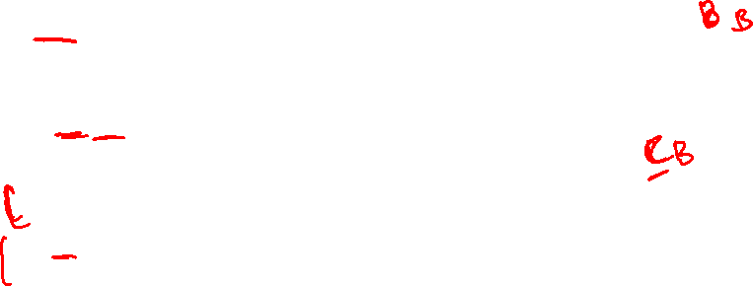
Inheritance (is-a) Base and Derived references
A
Base class reference can be created for base or derived class objects.
Base class reference can only see base class members, derived part still exist.
Compile time binding, system will call derived class functions only according to type of reference .
void main(){
  A a(2); B b(3, 4); C c(5,6,7);
  B & b1 = b; //B’s reference to B’s object
  b1.print(); //B’s print called.
  b1.funb(); b1.print(3);
  B & b2 = c; //B’s reference to C’s object
  b2.print(); //B’s print called.
  b2.funb(); b2.print(3);
  b2.func(); b2.print(3,8); //Compile time Error
  B & b3 = a; //Error: B’s pointer to A’s object
  //Every derived is a base but every base is not a derived.
  //Allowed if explicit cast made
}
B
C
b, b1
b=4
a=3
c=7
c,b2
b=6
a=5

Slide 13
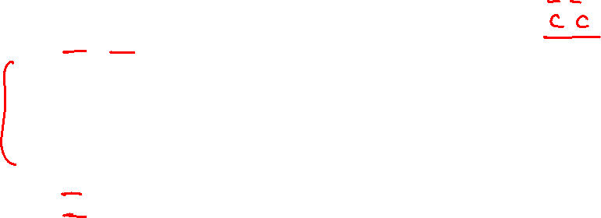
Inheritance (is-a) Base and Derived references
A
Derived class reference can be created for derived class objects.
Compile time binding, system will call derived class functions only according to type of reference .
void main(){
  A a(2); B b(3, 4); C c(5,6,7);
  C & c1 = c; //C’s reference to C’s object
  c1.print(); //C’s print called.
  c1.funb();
  c1.print(3);
  c1.func();
  c1.print(3,8);
  C & c2 = b; //Error: C’s reference to B’s object
  C & c3 = a; //Error: C’s reference to A’s object
  //Every derived is a base but every base is not a derived.
  //Allowed if explicit cast made
}
B
c=70
b=60
c, c1
a=5
C

Slide 14

Inheritance (is-a) Base and Derived references
A
void fun(A & a){
a.print(); //A’s print called print A’s data only.
}
void fun2(B & b){
b.print(); //B’s print called.
b.print(5);
}
void fun3(C & c){
c.print(); //C’s print called.
c.print(5,9);
}
void main(){
  C c1 (5,6,7);
  fun(c1);
  fun2(c1);
  fun3(c1);
}
B
C
c=7
b=6
a, b, c, c1
a=5

Slide 15

Inheritance (is-a) Base and Derived Pointers
A
void fun(A * a){
a->print(); //A’s print called print A’s data only.
}
void fun2(B * b){
b->print(); //B’s print called.
b->print(5);
}
void fun3(C * c){
c->print(); //C’s print called
c->print(5,9);
}
void main(){
  C c1 (5,6,7);
  fun(&c1);
  fun2(&c1);
  fun3(&c1);
}
B
C
a
b
c
c=7
b=6
c1
a=5

Slide 16

Inheritance (is-a) Compile Time Binding
Base class static object |  | Call base class functions only
Derived class static object |  | Call derived class functions & inherited functions. Overridden and overloaded functions.
Base class static object | Derived class static object | Call base class functions Slicing Issue only copies base data in base object
Derived class static object | Base class static object | Error: Explicit cast required
Base class pointer or reference | Base class object | Call base class functions
Base class pointer or reference | Derived class object | Call base class functions only
Derived class pointer or reference | Base class object | Error: Explicit cast required
Derived class pointer or reference | Derived class object | Call derived class functions & inherited functions. Overridden and overloaded functions.

